Slide 1



Update from the Tsepamo Study:
What have we learned about the NTD signal?
Rebecca Zash, MD
Assistant Professor, Harvard Medical School
Division of Infectious Diseases, Beth Israel Deaconess Medical Center
Research Associate, Harvard TH Chan School of Public Health and Botswana Harvard AIDS Institute Partnership

Slide 2
No Conflicts of Interest

Slide 3
Tsepamo Overview
  Tsepamo started in August 2014: Birth outcomes surveillance study at government maternity wards, covering ~45% of all births in the country (funded by NIH/NICHD, PI: Roger Shapiro)
Aim 1: to evaluate for neural tube defects (NTDs) with exposure to efavirenz at conception
  Hospital midwives performed standardized infant surface exam, recorded details of any abnormality and Tsepamo research assistants took photos with maternal consent
  Planned 4-year analysis (August 2018) with enrollment of 94,000 and expected NTD prevalence of 1 in 1000 births
Aim 2: to evaluate adverse birth outcomes by HIV- and ART-exposure
  Planned 2-year comparative analysis of ART regimens at conception

Slide 4
2017 Results: Comparative Safety of ART Regimens at Conception
*Key Finding: TDF/FTC/EFV associated with fewer adverse and severe adverse birth outcomes
Any Adverse Birth Outcome
Severe Adverse Birth Outcome
Any Adverse
 | HIV-uninfected (N=34,138) | TDF/FTC/EFV (N=2,503) | TDF/FTC/NVP (N=775) | ZDV/3TC/NVP (1,403) | TDF/FTC/ LPV-r (N=237) | ZDV/3TC/LPV-r (N=169)
Any Adverse Birth Outcome aRR* (95% CI) | - | ref | 1.2 (1.0,1.3) | 1.3 (1.2,1.4) | 1.3 (1.1,1.5) | 1.2 (1.0,1.5)
Severe Birth Outcome aRR* (95% CI) | - | ref | 1.4 (1.2, 1.7) | 1.7 (1.4,2.0) | 1.6 (1.2,2.1) | 1.9 (1.4,2.6)
Severe Adverse
Zash et al JAMA Peds 2017
Notes:
So, Tsepamo was plowing along. And we had some interesting results from our planned 2 year analysis, showing that the TDF/FTC/EFV regimen, shown here in the red bars, actually was associated with fewer adverse birth outcomes and severe adverse birth outcomes than the other regimens being used in Botswana. It was a bit ironic, we felt, that EFV had been avoided for so many years in women due to this concern for NTDs, and it turned out actually to have significantly better pregnancy outcomes. And not subtly—we are talking about 10-12% absolute differences in both all advrse and severe adverse outcomes.

Slide 5
2017 Results: Comparative Safety of ART Regimens at Conception
*Key Finding: LPV-r based regimens with large absolute increases in severe adverse birth outcomes
Any Adverse Birth Outcome
Severe Adverse Birth Outcome
Any Adverse
 | HIV-uninfected (N=34,138) | TDF/FTC/EFV (N=2,503) | TDF/FTC/NVP (N=775) | ZDV/3TC/NVP (1,403) | TDF/FTC/ LPV-r (N=237) | ZDV/3TC/LPV-r (N=169)
Any Adverse Birth Outcome aRR* (95% CI) | - | ref | 1.2 (1.0,1.3) | 1.3 (1.2,1.4) | 1.3 (1.1,1.5) | 1.2 (1.0,1.5)
Severe Birth Outcome aRR* (95% CI) | - | ref | 1.4 (1.2, 1.7) | 1.7 (1.4,2.0) | 1.6 (1.2,2.1) | 1.9 (1.4,2.6)
Severe Adverse
Zash et al JAMA Peds 2017
Notes:
So, Tsepamo was plowing along. And we had some interesting results from our planned 2 year analysis, showing that the TDF/FTC/EFV regimen, shown here in the red bars, actually was associated with fewer adverse birth outcomes and severe adverse birth outcomes than the other regimens being used in Botswana. It was a bit ironic, we felt, that EFV had been avoided for so many years in women due to this concern for NTDs, and it turned out actually to have significantly better pregnancy outcomes. And not subtly—we are talking about 10-12% absolute differences in both all advrse and severe adverse outcomes.

Slide 6
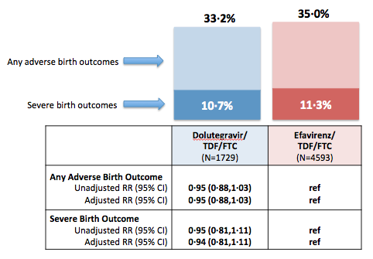
Tsepamo and Dolutegravir
In mid-2016, dolutegravir rolled out nationally in Botswana to all adults (including pregnant women), allowing for inclusion of DTG exposure in comparative analyses
Tsepamo provided the first data on safety of DTG when starting during pregnancy
  No increased signal for congenital abnormalities among 280 women who started DTG during the first trimester (median 10 weeks GA)
Zash et al. Lancet GH, 2018

Slide 7
Tsepamo Study Preliminary NTD Results, May 2018
In April 2018, we were asked by WHO to provide any preliminary data available for upcoming HIV guidelines committee meeting for women on DTG from conception…
NTDs/Exposures | 4/426 | 14/11,300 | 3/5,787 | 0/2,812 | 61/66,057
% with NTD (95% CI) | 0.94% (0.37%, 2.4%) | 0.12% (0.07%, 0.21%) | 0.05% (0.02%, 0.15%) | 0% (0%, 0.13%) | 0.09% (0.07%, 0.12%)
Prevalence Difference (95% CI) | ref | 0.82% (0.24%, 2.3%) | 0.89% (0.31%, 2.3%) | 0.94% ( 0.35%, 2.4%) | 0.85% (0.27%, 2.3%)
Zash R et al. N Engl J Med 2018

Slide 8
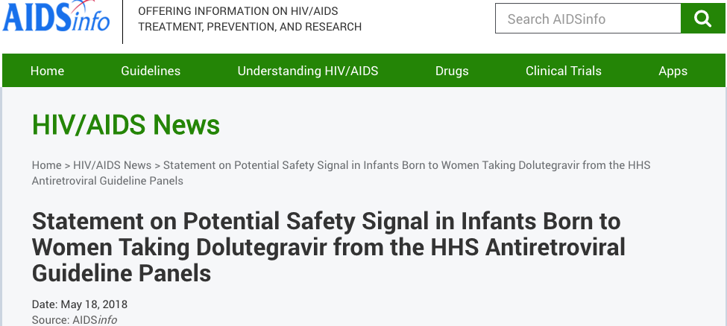
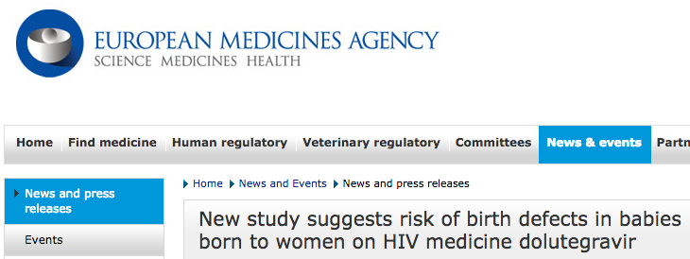
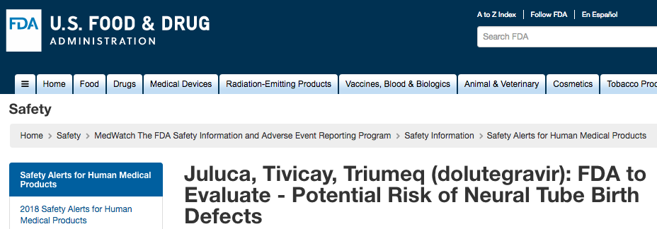
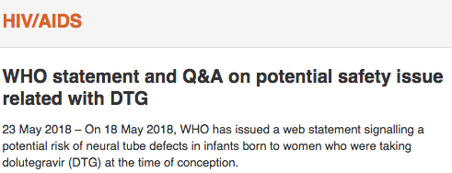
May 2018: Possible DTG Safety Signal Reported
Notes:
On May 18th, the WHO, FDA and EMA all put out warnings about the potential link between taking dolutegravir-based ART and neural tube defects, which was based on the world that I have involved with in Botswana

Slide 9
Zash et al NEJM 2019, IAS 2019
March 2019 updated NTD Prevalence
NTDs/Exposures | 5/1683 | 15/14792 | 3/7959 | 1/3840 | 70/89372
% with NTD (95% CI) | 0.30% (0.13, 0.69) | 0.10% (0.06, 0.17) | 0.04% (0.01, 0.11) | 0.03% (0.0, 0.15) | 0.08% (0.06, 0.10)
Prevalence Difference (95% CI) | ref | 0.20% (0.01, 0.59) | 0.26% (0.07, 0.66) | 0.27% (0.06, 0.67) | 0.22% (0.05, 0.62)

Slide 10
Could Results be Explained by Bias?
Confounding
None of the 5 cases had any measured potential confounding factor and no difference in measured confounders except maternal age which would bias toward the null
Misclassification
Outcome: 4/5 cases with photo confirmation, description of anencephaly
Exposure: All cases started DTG >3 months prior to conception in the DTG era
  Confirmed HIV, ART and other medication exposures with all available medical records and with mother for all spine/head defects throughout the study

Slide 11
Could results be due to historical bias?
Since May 2018 the overall rate of NTDs lower than in prior years 12/29,979, 0.04% vs. 98/119.033, 0.08% (overall)
  1/1275 DTG Conception (0.08%)
  1/3492 Non-DTG Conception (0.03%)
  0/2172 EFV-Conception (0.00%)
  1/1028 DTG starts in pregnancy (0.10%)
  9/23,315 HIV-negative (0.04%)
Sensitivity analysis restricting to time period after DTG rollout was similar
  Prevalence difference comparing DTG-conception vs non-DTG at conception during this period was 0.22% (95% CI 0.01, 0.62).

Slide 12
What about other data sources?

Slide 13
Power to detect a 10-fold increase
<10 % power to detect a 10x increase

Slide 14
Power to detect a 10-fold increase

Slide 15
Power to detect a 10-fold increase
Prospective (except Brazil)
Internal comparator groups
Includes evaluation for outcome among stillbirth/terminations

Slide 16
NTD Prevalence in largest studies
Tsepamo: 5/1683 (0.30%)
Brazil: 0/382 (0.00%)
APR: 1/247 (0.40%)
Botswana MOH-CDC: 1/152 (0.66%)

Slide 17
Is there biologic plausibility?
Animal studies in preclinical drug development did not show any increased risk of birth defects
neither did early animal studies of thalidomide
In response to the signal, basic science studies developed to:
1. Evaluate potential mechanisms (folate receptor antagonism) in cell culture
2. Evaluate for birth defects in animal model (rat, zebrafish, mouse)

Slide 18
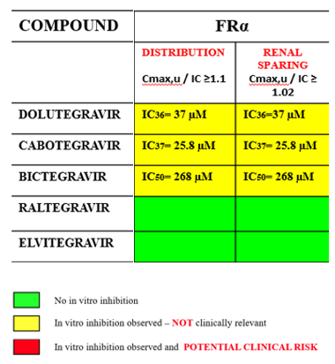
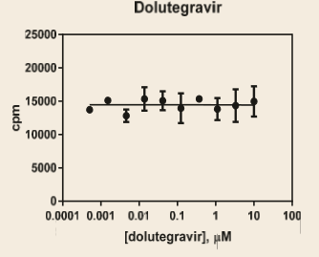
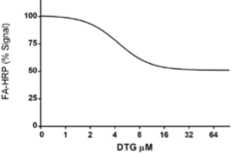
Mechanism: Folate receptor antagonism?
ViiV
(Zamek-Gliszczynski Drug Metab Distrib 2019)
Gilead
(Liclican 17th Euro HIV/Hep 2019)
Baylor
(Cabrera R AIDS 2019 epub)
Intestinal FOLR
Renal FOLR
56% ↓ signal
Gilead-no
inhibition
low levels
ViiV- inhibits
at high levels
As ↑ DTG in medium, ↓ binding
indicated by ↓ folate signal in y axis
Transfected HeLa carcinoma cells expressing FRꭤ; no inhibition by DTG at levels up to 10 uM level (similar curves with EVG, BIC or RAL)
Transfected kidney cells expressing FRꭤ;
Used placental cell assay with placental FRꭤ;
DTG inhibition at high levels (>37 uM), not viewed as clinically significant at free drug levels (Total DTG C_{max} 8.3 uM but free DTG C_{max} 0.1 uM)
partial/non-competitive inhibition by DTG in concentration dependent manner, start ~4.4 uM but primarily>8 uM; seen for EVG, minimal CAB, but not RAL, TDF, FTC
Slide courtesy of Lynne Mofenson

Slide 19
Animal model for NTDs?
ViiV: rat embryo culture, exposed to DTG 6uM and 10uM d 6-11 gestation; high folate background, poor penetration DTG into embryo; did not see NTD with DTG, but did with valproate control (Posobiec et al. 2019 Pediatric HIV Workshop Poster).
U. Nebraska: demonstrated DTG can be found in mouse fetal brain with in utero exposure (Bade AN et al. CROI 2019 poster 430).
Baylor: zebrafish showed time-dependent DTG toxicity (at 1-5 hr but not 6-8 hr post-fertilization) with high DTG levels that was reversed with folate administration (Cabrera R et al. AIDS 2019 epub).
Slide courtesy of Lynne Mofenson

Slide 20
Animal model for NTDs?
ViiV: rat embryo culture, exposed to DTG 6uM and 10uM d 6-11 gestation; high folate background, poor penetration DTG into embryo; did not see NTD with DTG, but did with valproate control (Posobiec et al. 2019 Pediatric HIV Workshop Poster).
U. Nebraska: demonstrated DTG can be found in mouse fetal brain with in utero exposure (Bade AN et al. CROI 2019 poster 430).
Baylor: zebrafish showed time-dependent DTG toxicity (at 1-5 hr but not 6-8 hr post-fertilization) with high DTG levels that was reversed with folate administration (Cabrera R et al. AIDS 2019 epub).
Though suggestive, in vitro and animal studies are conclusive

Slide 21
Conclusions about the signal?
  Our current surveillance suggests an NTD prevalence of 0.30% among women on DTG at conception which is slightly higher than in all other exposure groups
    The estimated difference is small (0.20-0.27%)
    Supported by 2 additional data sources (APR, Botswana MOH/CDC)
Increasing evidence that we may not be able to “refute the signal”

Slide 22
Lessons learned from Tsepamo
For many years “pregnancy safety” = “risk of total birth defects”

Slide 23
Birth Defects are one of many potential risks
Conception
Birth
Year 1
Year 2
Year 3
Year 4
Year 5
Pregnancy complications
-HTN/Pre-e
-Anemia
-Weight gain
-miscarriage
-intrauterine MTCT
Adverse Birth Outcomes
-birth defects
-preterm
-SGA/LBW
-stillbirth
-early NND
-intrapartum MTCT
Childhood morbidity and mortality
-neonatal death
-under5 death
-postpartum MTCT
-pediatric HIV infection
Long-term pediatric outcomes
-neurodevelopment
-malignancy
-immune dysfunction
There is a lack of data for the effect of most ARVs on most outcomes
Notes:
And even beyond the uncertainties of DTG and NTDs—there is really a lack of data for the effect of ART regimens on most of these outcomes.

Slide 24
Birth Defects are one of many potential risks
Conception
Birth
Year 1
Year 2
Year 3
Year 4
Year 5
Pregnancy complications
-HTN/Pre-e
-Anemia
-Weight gain
-miscarriage
-intrauterine MTCT
Adverse Birth Outcomes
-birth defects
-preterm
-SGA/LBW
-stillbirth
-early NND
-intrapartum MTCT
Childhood morbidity and mortality
-neonatal death
-under5 death
-postpartum MTCT
-pediatric HIV infection
Long-term pediatric outcomes
-neurodevelopment
-malignancy
-immune dysfunction
A medication may increase risk of one and decrease the risk of another
Notes:
And even beyond the uncertainties of DTG and NTDs—there is really a lack of data for the effect of ART regimens on most of these outcomes.

Slide 25
Public Health Impact of Adverse Effects
DTG increased the risk of neural tube defects by 3x?
  Neural tube defects occur in 1 per 1000 births
  With exposure to DTG there would be 3 NTDs per 1000 births
  DTG results in an excess of 2 bad outcomes in a population of 1000 exposed
LPV-r increased the risk of preterm delivery by 1.4x?
  Preterm delivery occurs in 100 per 1000 births
  With exposure to LPV-r there would be 140 per 1000 births
  LPV-r results in an excess of 40 bad outcomes in a population of 1000 exposed

Slide 26
Weighing risk vs. benefit
How to weigh small risk of NTD against potentially large benefits of DTG?
(More details in the next presentation)

Slide 27
Lessons learned from Tsepamo
For many years ‘pregnancy safety data’ seen as only important only for pregnant women

Slide 28
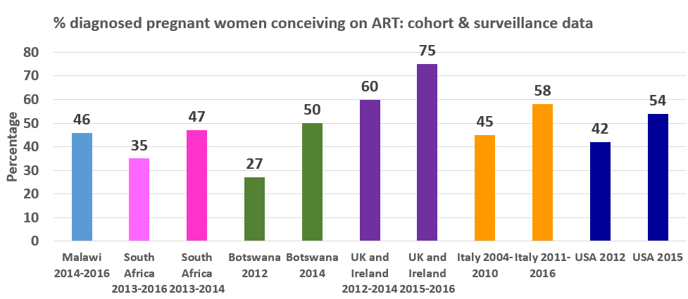
Increasing proportions of women are conceiving on ART worldwide
Slide courtesy of Claire Thorne
** >70% in 2018
Tippett-Barr et al Lancet HIV 2018; Chetty et al PLoS One 2018; Brittain et al JAIDS 2019; Zash et al Expert Opin Drug Safety 2016; Peters et al BHIVA 2018; Chiappini et al JAIDS 2018
Notes:
In Test and Treat era, increasing proportion of women enter pregnancy already receiving ART.
Quite difficult to find these data – and out of date very quickly – data from Tsepamo study show that overall % of women on ART from before conception between 2014 and May 2018 was 58%.

Slide 29
Increasing proportions of women are conceiving on ART worldwide
Slide courtesy of Claire Thorne
Consideration of the safety of ART in pregnancy and pregnancy intentions when starting ART for all women of reproductive capacity
** >70% in 2018
Tippett-Barr et al Lancet HIV 2018; Chetty et al PLoS One 2018; Brittain et al JAIDS 2019; Zash et al Expert Opin Drug Safety 2016; Peters et al BHIVA 2018; Chiappini et al JAIDS 2018
Notes:
In Test and Treat era, increasing proportion of women enter pregnancy already receiving ART.
Quite difficult to find these data – and out of date very quickly – data from Tsepamo study show that overall % of women on ART from before conception between 2014 and May 2018 was 58%.

Slide 30
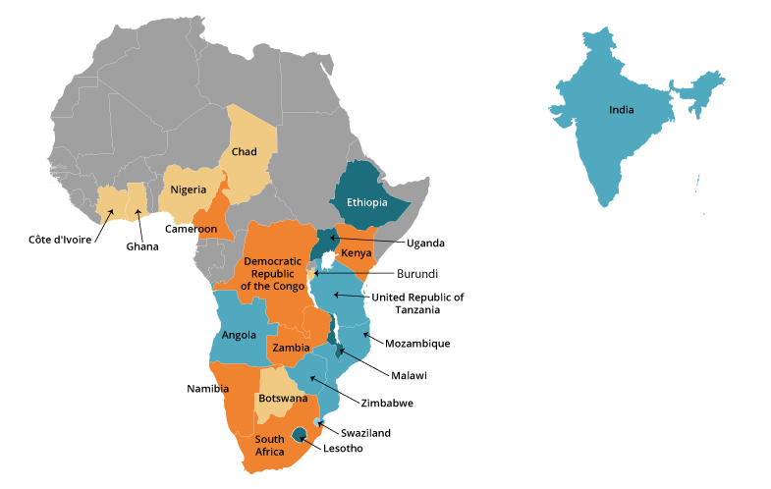
Lessons learned from Tsepamo
Women make up ~ HALF of the global population of people living with HIV so a public health approach to ART for all adults that maintains gender equity requires pregnancy safety data
We need to build sustainable surveillance in the high HIV-burden countries where >90% of ART pregnancy exposures occur

Slide 31
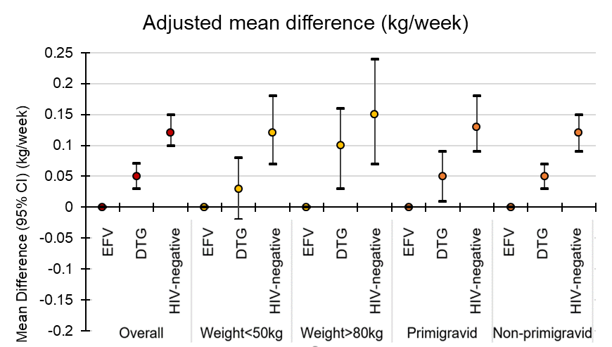
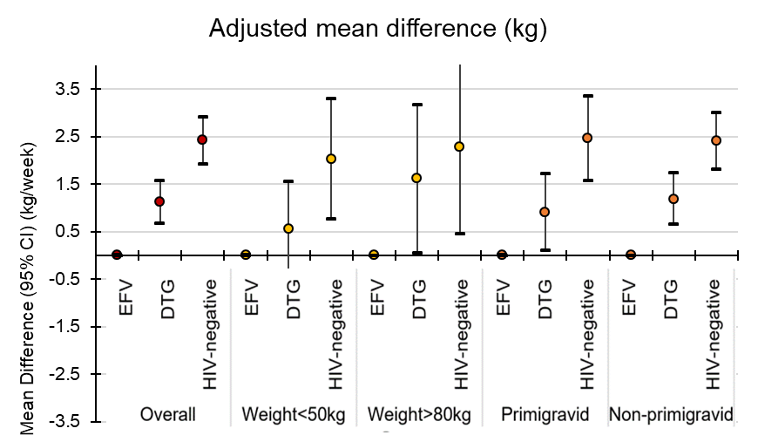
Weight gain during pregnancy among women initiating dolutegravir in Botswana
Caniglia et al. Late Breaker Poster (presented today at 12:30)
Conclusions:
Women initiating DTG compared with EFV during pregnancy gained more weight between 18 and 36 weeks, particularly among those with higher pre-ART weight
Neither group gained as much as HIV-uninfected women

Slide 32
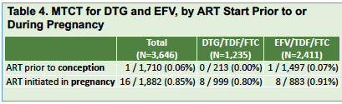
In utero mother to child transmission in Botswana does not differ between EFV/TDF/FTC and DTG/TDF/FTC
Davey et al. Late Breaker Poster EC30
Conclusions:
Reassurance that DTG-based ART maintains a low MTCT risk, with no apparent benefit as compared with EFV-based ART
Key to reducing in-utero HIV transmission is starting women on ART early in pregnancy
OR for vertical transmission for DTG vs. EFV started in pregnancy is 0.88 (95% CI .29,2.71)
63% of transmission occurred when mothers started ART in the third trimester

Slide 33
Lessons learned from Tsepamo
Tsepamo brought renewed focus on old problems
Lack of access to contraception and integration of comprehensive sexual and reproductive health
Lack of implementation of food fortification with folate which can decrease NTDs by more than half
Lack of inclusion of a wide variety of community voices in policy decision and research from the beginning
Insufficiency of current post-marketing pharmacovigilance systems

Slide 34
Lessons learned from Tsepamo
Tsepamo brought renewed focus on old problems
Lack of access to contraception and integration of comprehensive sexual and reproductive health
Lack of implementation of food fortification with folate which can decrease NTDs by more than half
Lack of inclusion of a wide variety of community voices in policy decision and research from the beginning
Insufficiency of current post-marketing pharmacovigilance systems
Addressing these problems will improve the health of all people—men and women, regardless of HIV status

Slide 35
Conclusions
Growing evidence that we may not be able to “refute the signal” but this should not preclude wider DTG use among all people living with HIV
We should require a plan for pregnancy safety surveillance for all new ARVs and biomedical HIV treatment and prevention strategies

Slide 36
Acknowledgements
Roger Shapiro
Botswana Ministry of Health and Wellness
NIH / NICHD
Lynne Mofenson, Claire Thorne
Modiegi Diseko, Gloria Mayondi, Joseph Makema, Mompati Mmalane, Tendani Gaolathe, Shahin Lockman
Sonya Davey, Ellie Caniglia, Arielle Isaacsson

